Slide 2
Configuring and Deploying an Engaging Service Portal
LAB0261: Platform Essentials
Sushruth Chandrashekar
Dylan Lindgren
Senior UI Developer, Platform Innovation
Senior UI Developer, Platform Innovation

Slide 3
Agenda
Introductions
Portals & Pages
Widgets
External Dependencies & Best Practices
Bonus Lab!

Slide 4
Speaker introduction
Name: Sushruth Chandrashekar
Title: Senior UI Developer
Function: Platform Innovation Practice
Company: ServiceNow (San Diego, USA)
Experience/Expertise:
Current Projects:

Slide 5
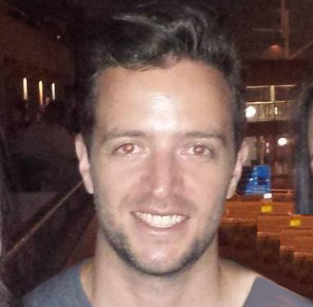
Speaker introduction
Name: Dylan Lindgren
Title: Senior UI Developer
Function: Platform Innovation Practice
Company: ServiceNow (Sydney, Australia)
Experience/Expertise: 20 years of building web pages and apps as a full-stack web developer
Current Projects: Working on building innovative solutions for clients on the ServiceNow platform, with a focus on UX and pushing boundaries.

Slide 6
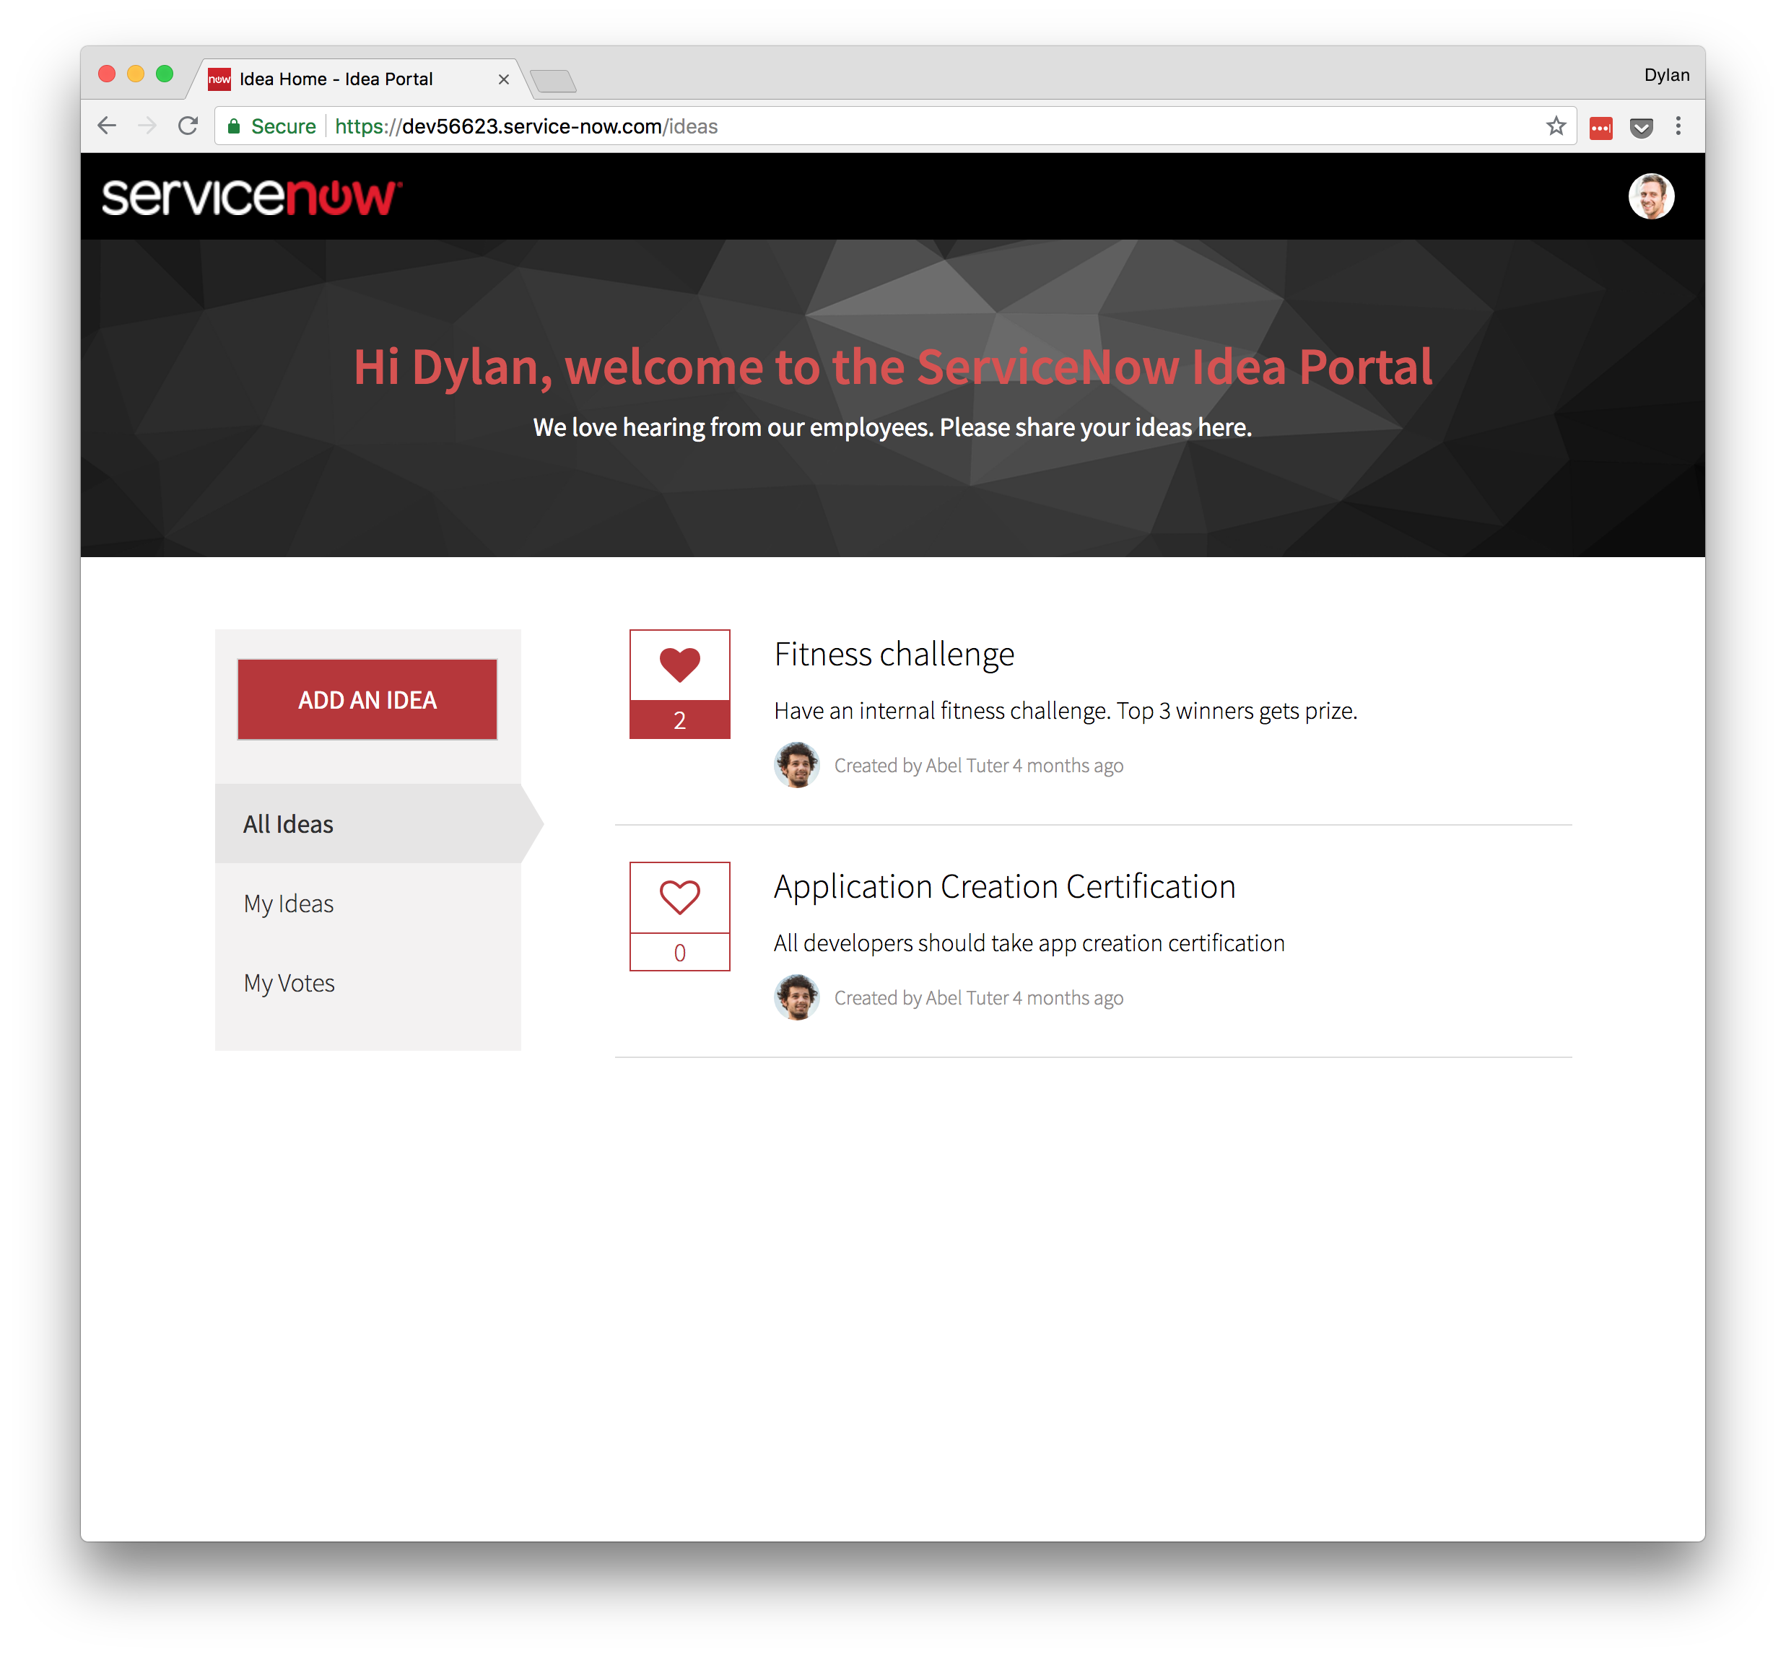
What are we building?
Ideation portal
Submit new ideas
Vote on other ideas
Filter ideas
All ideas
Ideas I’ve submitted
Ideas I’ve voted on
Notes:
So let’s go over what we’re building…

Slide 7
Exercise 1
The Portal Record

Slide 8
Exercise 2
Cloning and Creating Pages

Slide 9
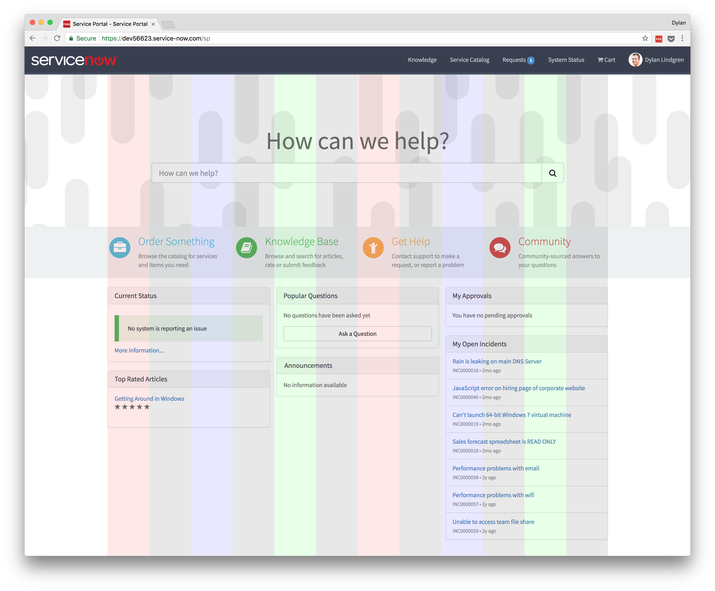
Bootstrap
CSS framework
12 columns
Notes:
Bootstrap is a core part of Service Portal.
Bootstrap is a CSS framework that was developed by Twitter.
Bootstrap partitions your page into a grid of 12 columns.
you can arrange your items on this grid
See in the screenshot of the OOB Service Portal that the items all align to the grid of columns?

Slide 10
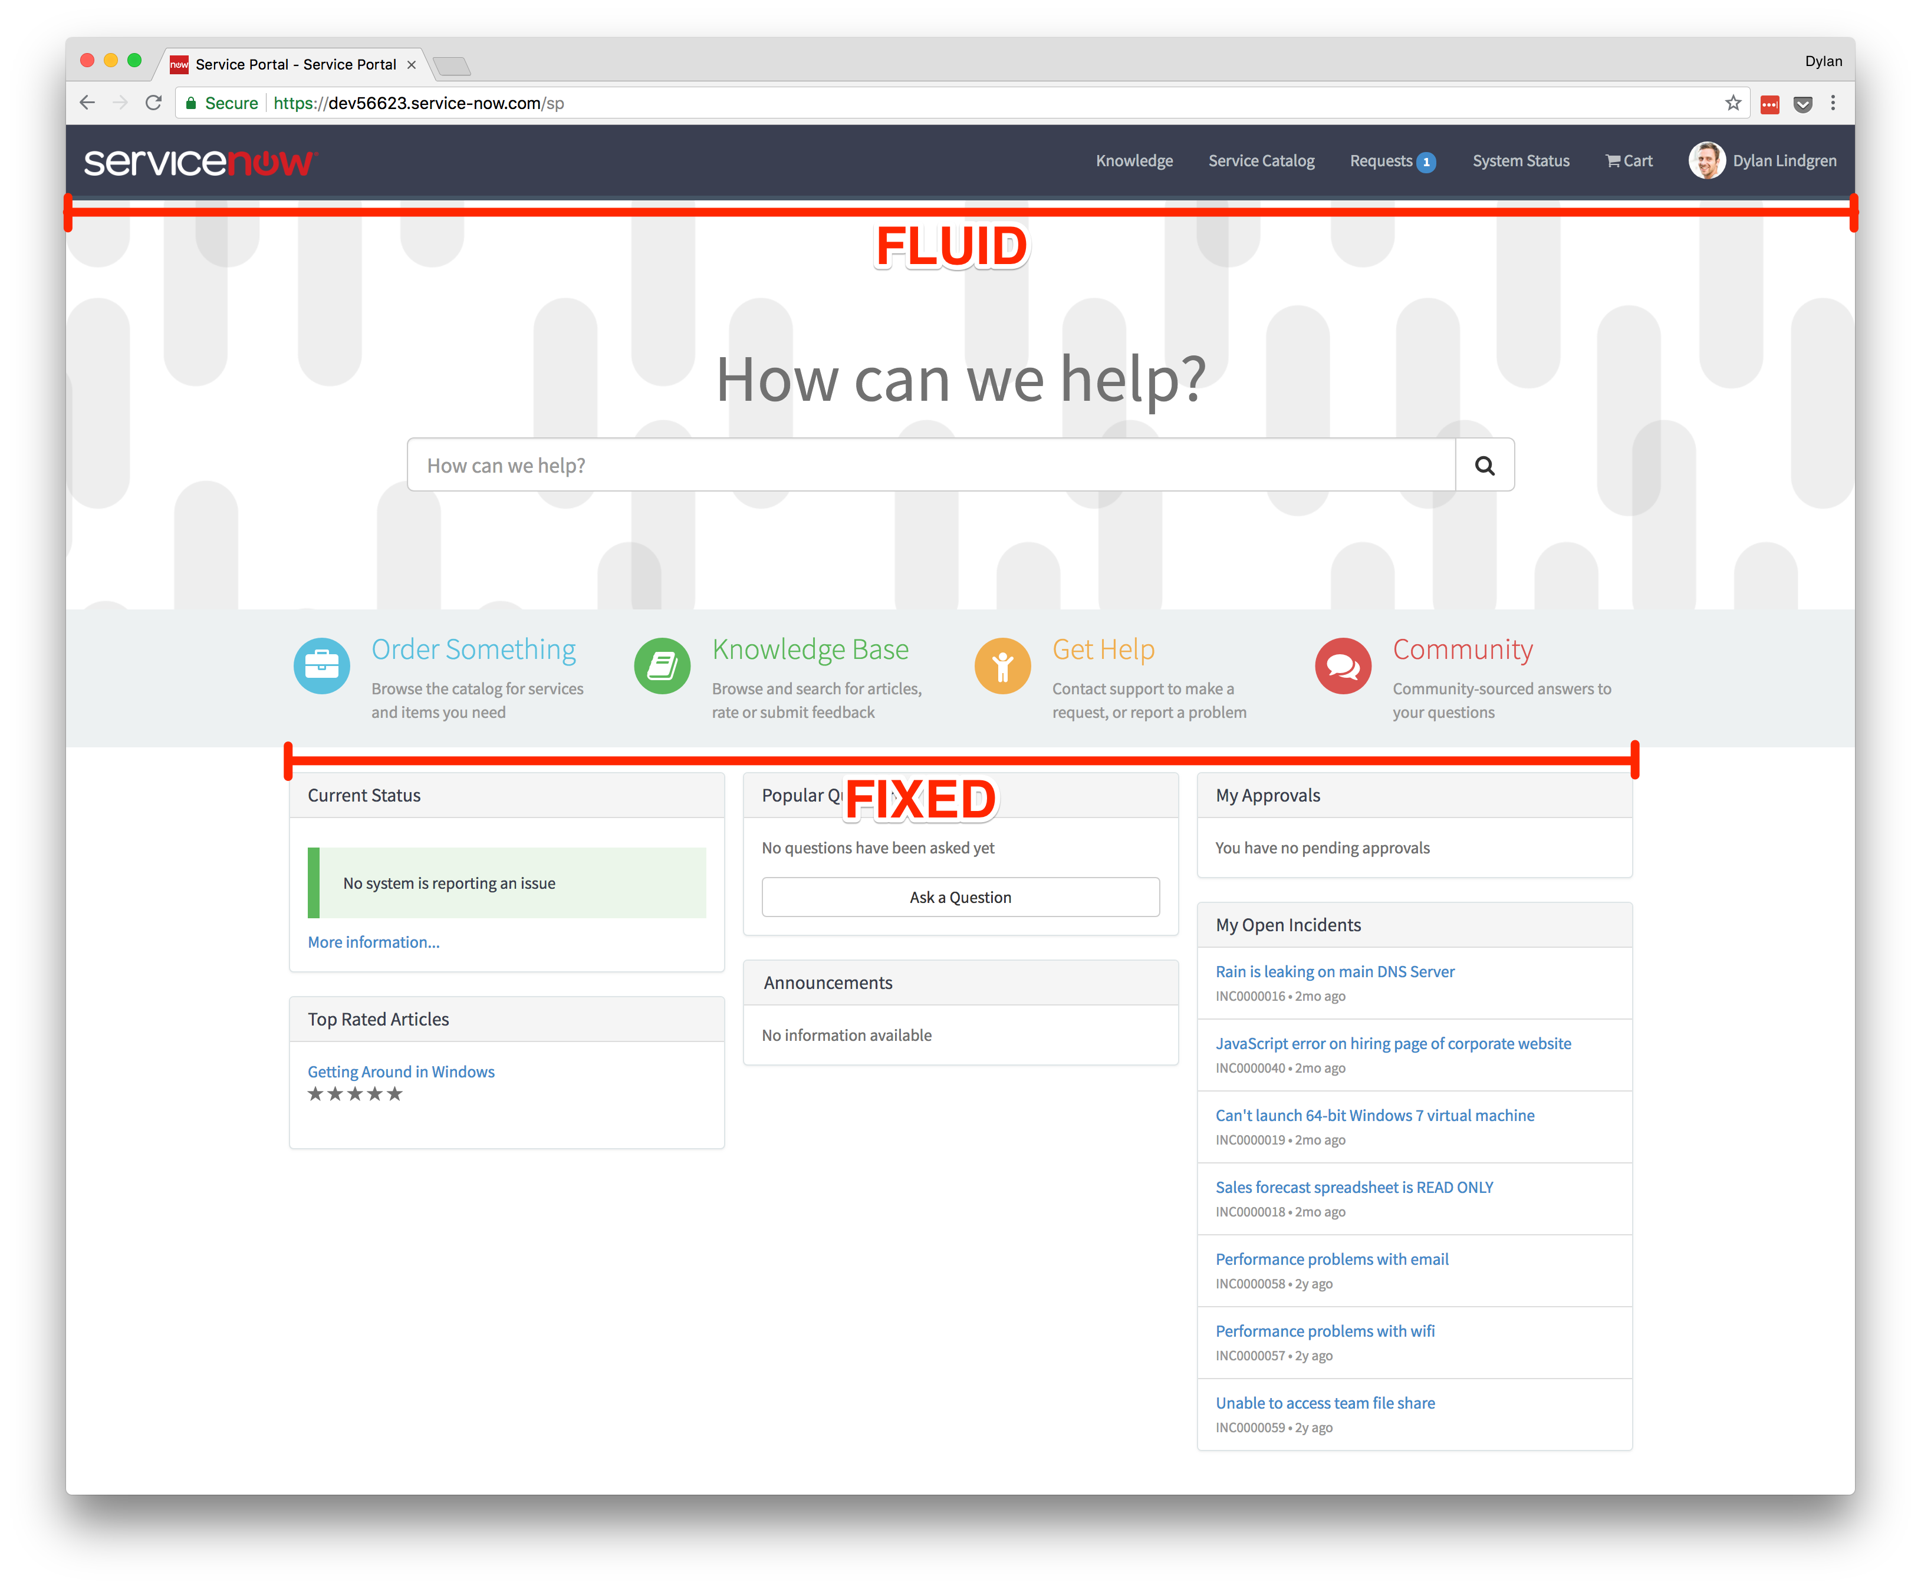
Service Portal + Bootstrap
In Service Portal, bootstrap columns are embedded inside containers.
Containers can be…
Fixed
Default
Fixed container width for each screen size
Extra small
Small
Medium
Large
Fluid
Takes up full width of screen for all screen sizes

Slide 11
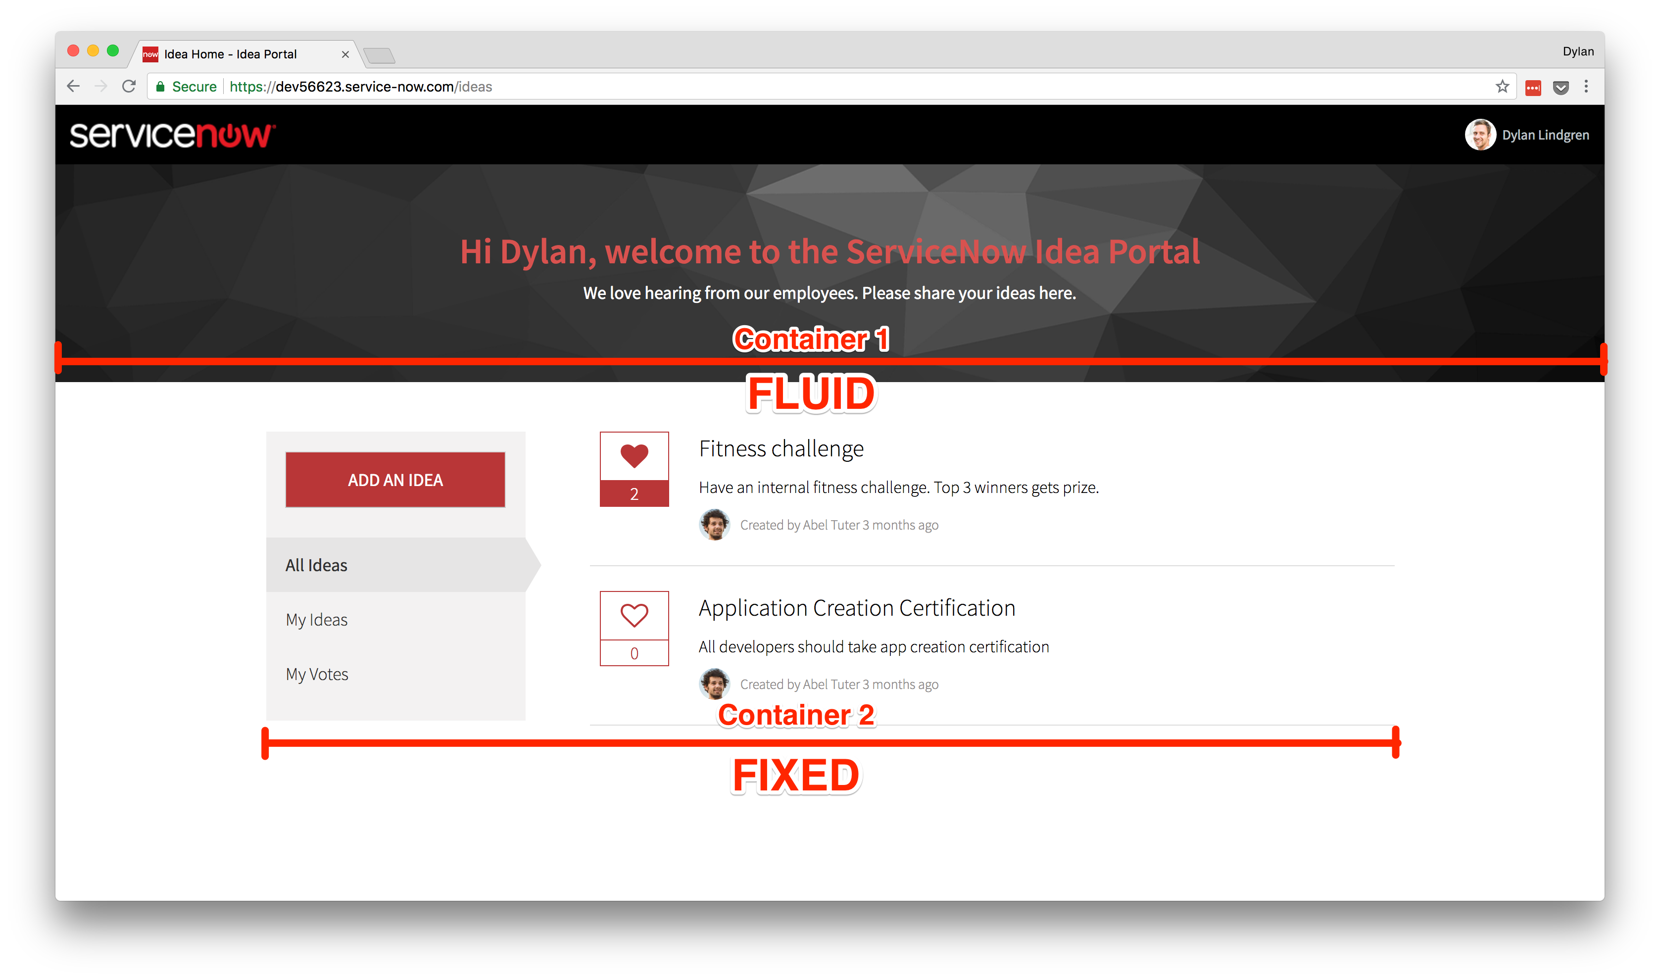
Idea Home Container Layout
Notes:
You can see that on our Idea Home page…
We have two containers
The top container is fluid, hence why it takes up the full width of the page
The bottom container is fixed, hence that on a large screen the most the container will expand to is 1170px.
Fixed containers will always be horizontally centered.

Slide 12
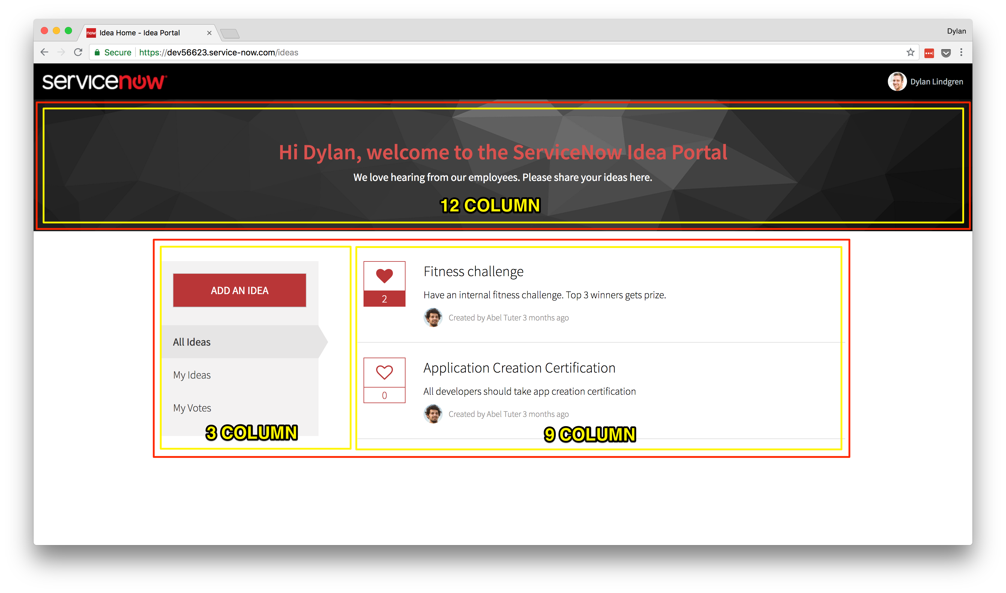
Idea Home Columns
Notes:
Within each container we can have columns.
You can have as many columns in a container as you like, however the max width of a column is 12 units.
You can see in our top container, we have a single column which is set to 12 units.
In our bottom container, we have 2 columns, the first taking 3 units, the second taking 9 units.

Slide 13
Exercise 3
Banner Widget

Slide 14
Exercise 4
Sidebar Widget

Slide 15
AngularJS Event system
You can use it to communicate between widgets.
Declare an event as having happened.
Throughout other places in your application, you can listen for that event.
Data can be passed with the event.

Slide 16
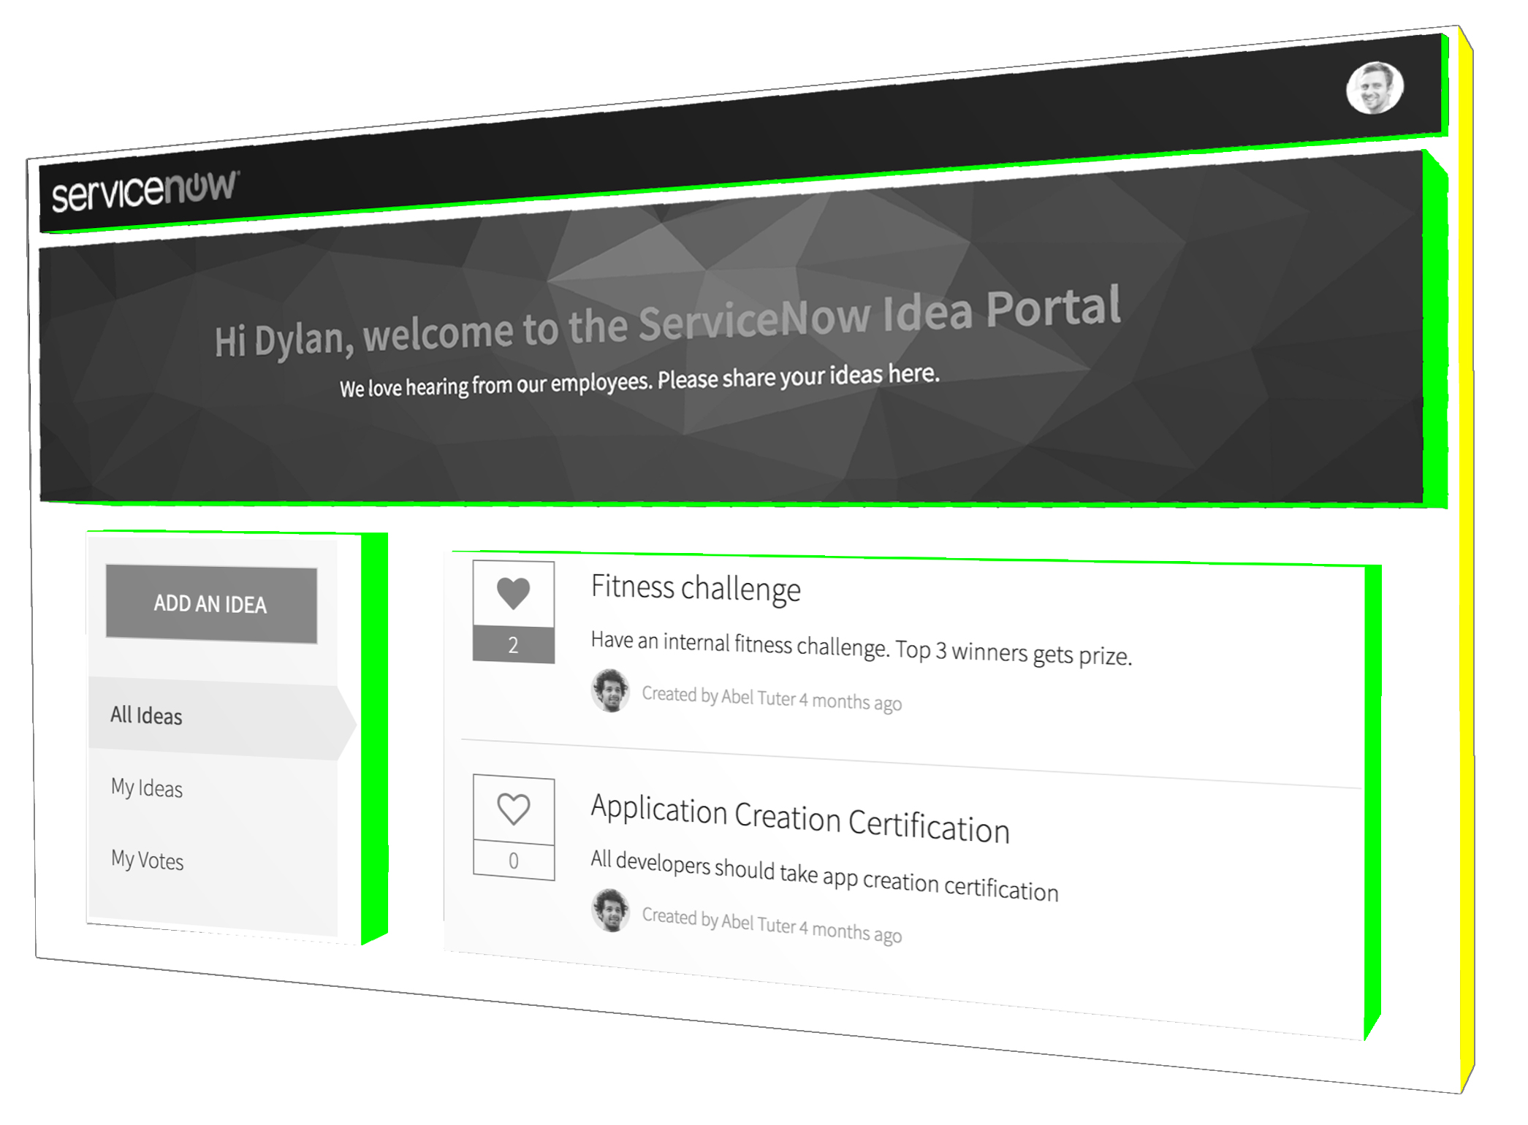
AngularJS Scopes
Important to understand for widget communication
Root-scope
Child-scopes
Notes:
If you embed a widget, a child scope will have a child scope of itself.
If you don’t use embedded widgets, all widgets will be siblings of each other in the “scope tree”

Slide 17
$broadcast(), $emit(), and $on()
$broadcast() passes the message downwards through the scope tree.
$emit() passes the message upwards through the scope tree.
$on() listens for messages that are received by the local scope.
All functions exist in on both the local-scope ($scope) and root-scope ($rootScope) objects.
Notes:
Scope 3 is an embedded widget, which is embedded in Scope 1.
Scope 1 and Scope 2 are widgets placed on the page using Service Portal Designer – these are siblings of each other.

Slide 18
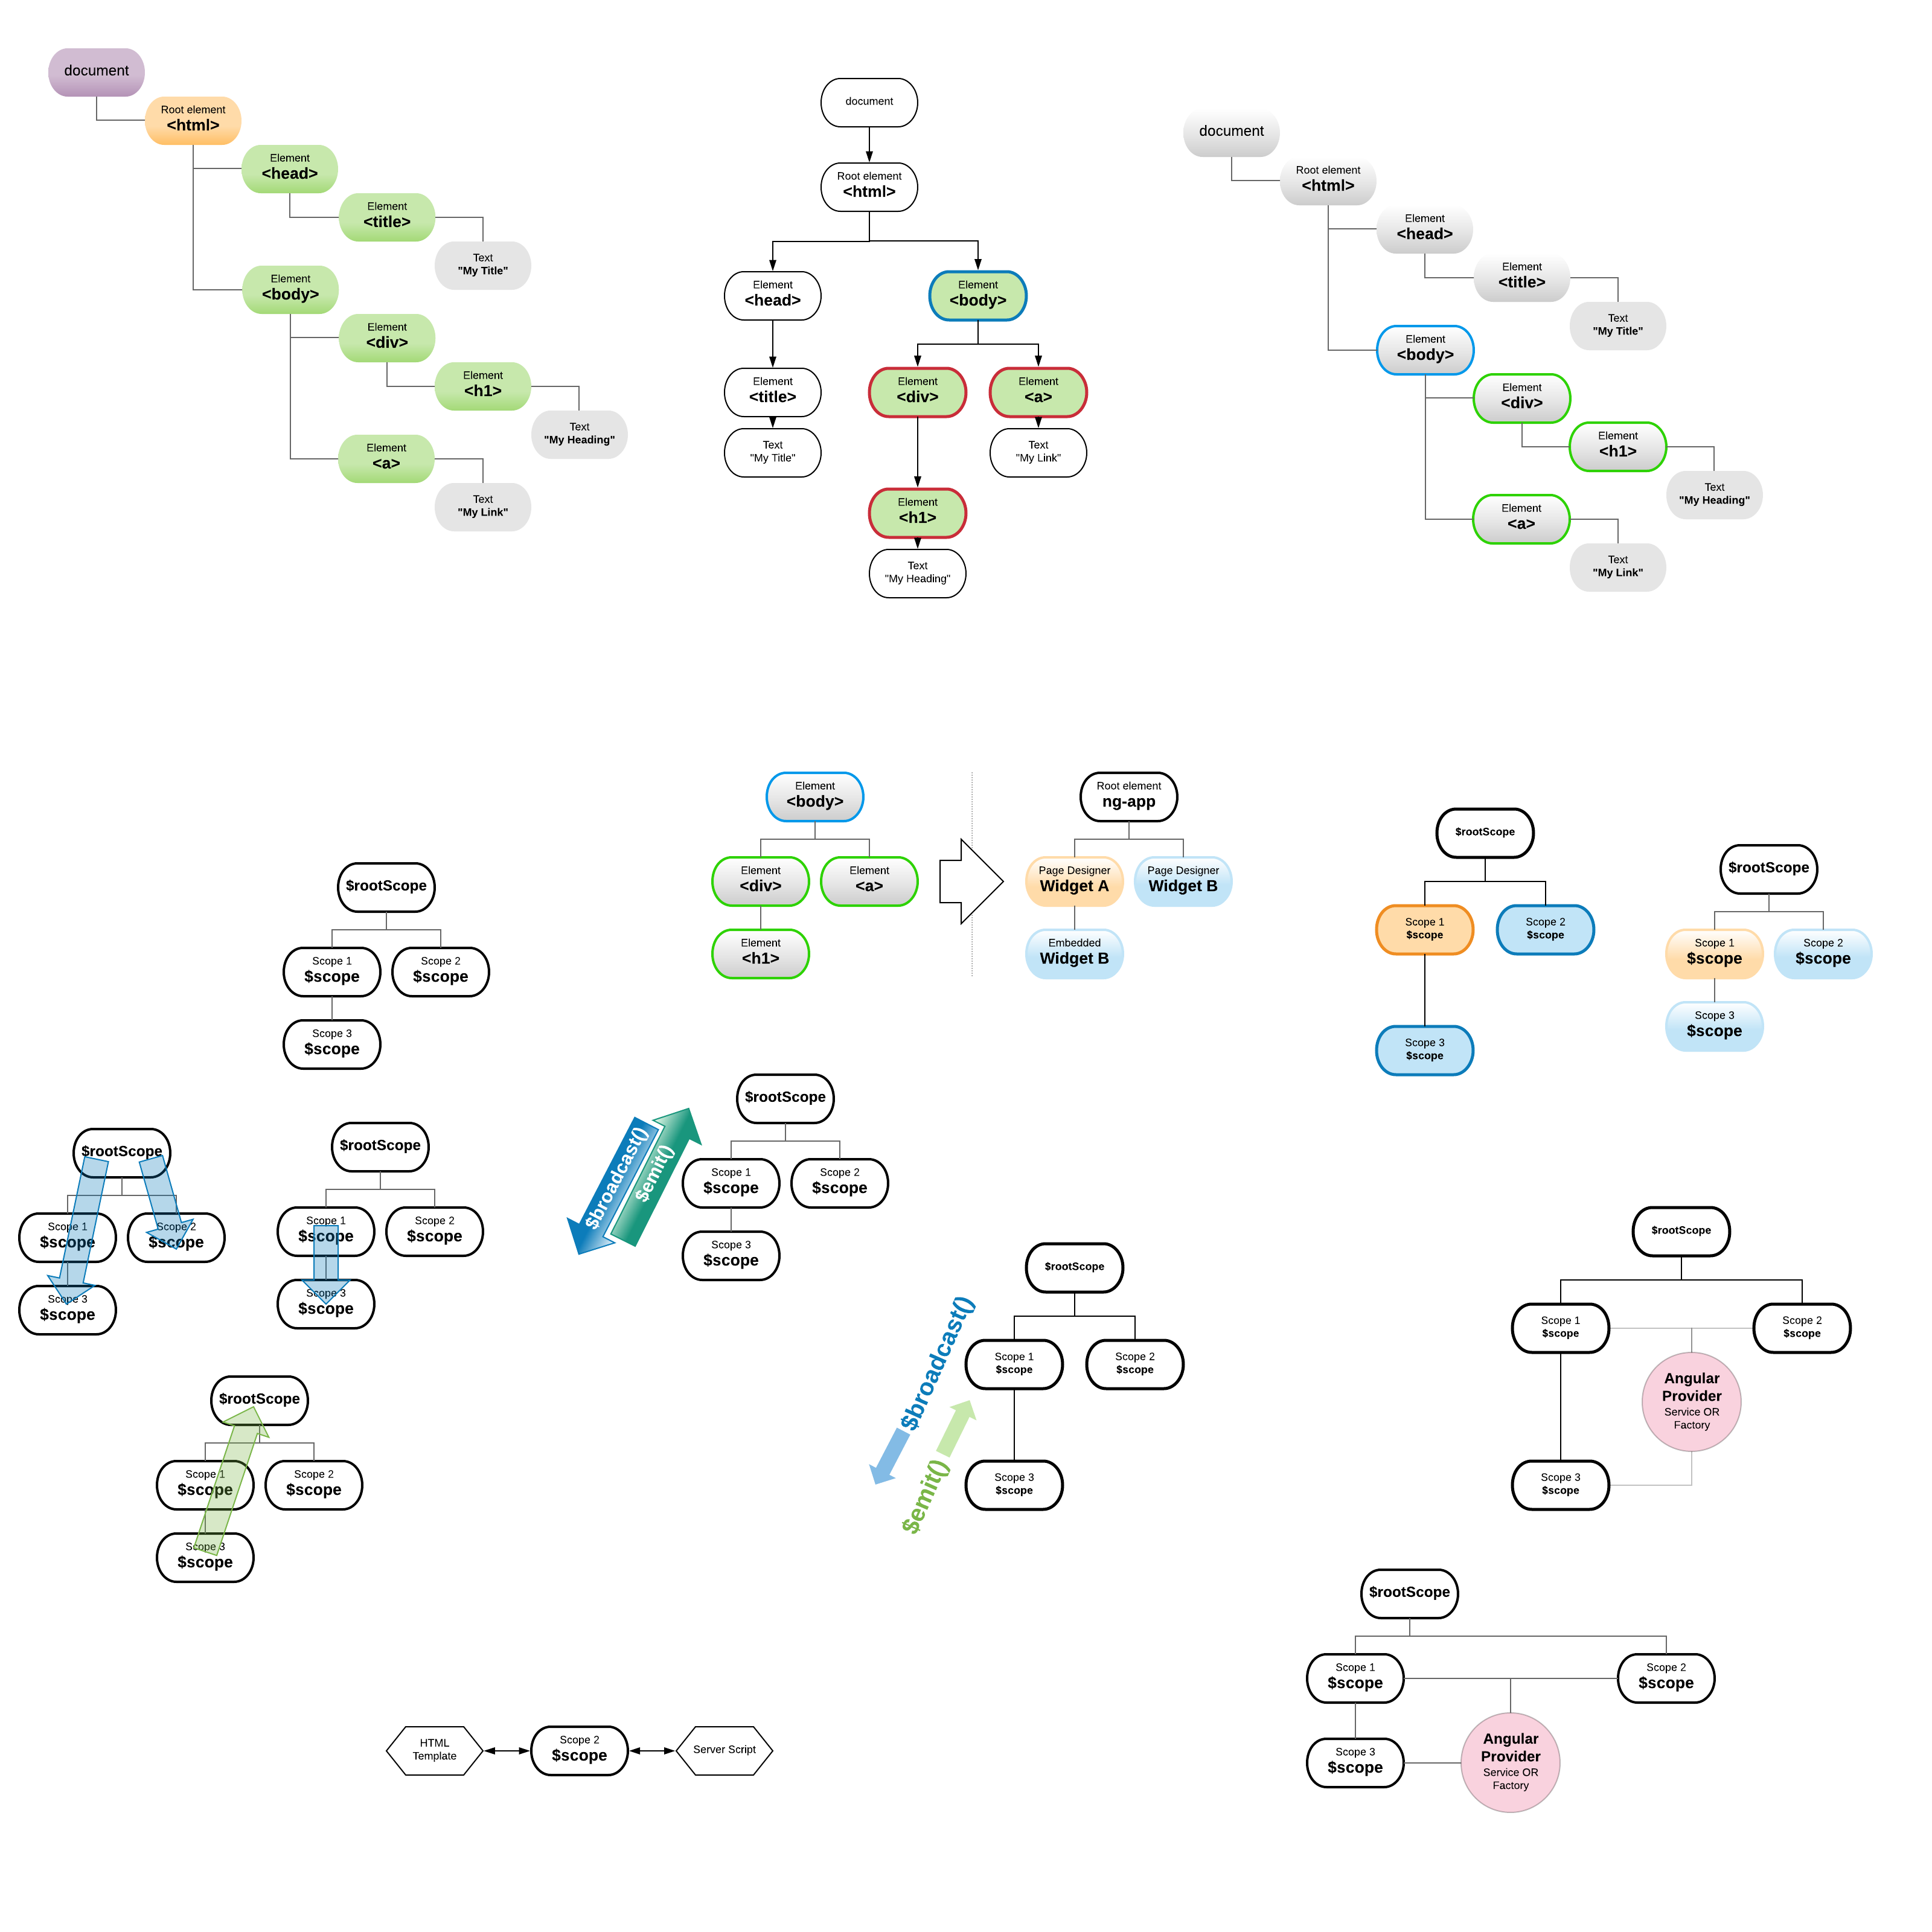
Examples
$scope vs $rootScope
An event $broadcast() on $rootScope will be heard by all child scopes of the root scope (i.e. every scope!)
An event $broadcast() on $scope will be heard by child scopes of that scope.
Any event $emit() on $scope will be heard by parent scopes of that scope (i.e. the root-scope too!)

Slide 19
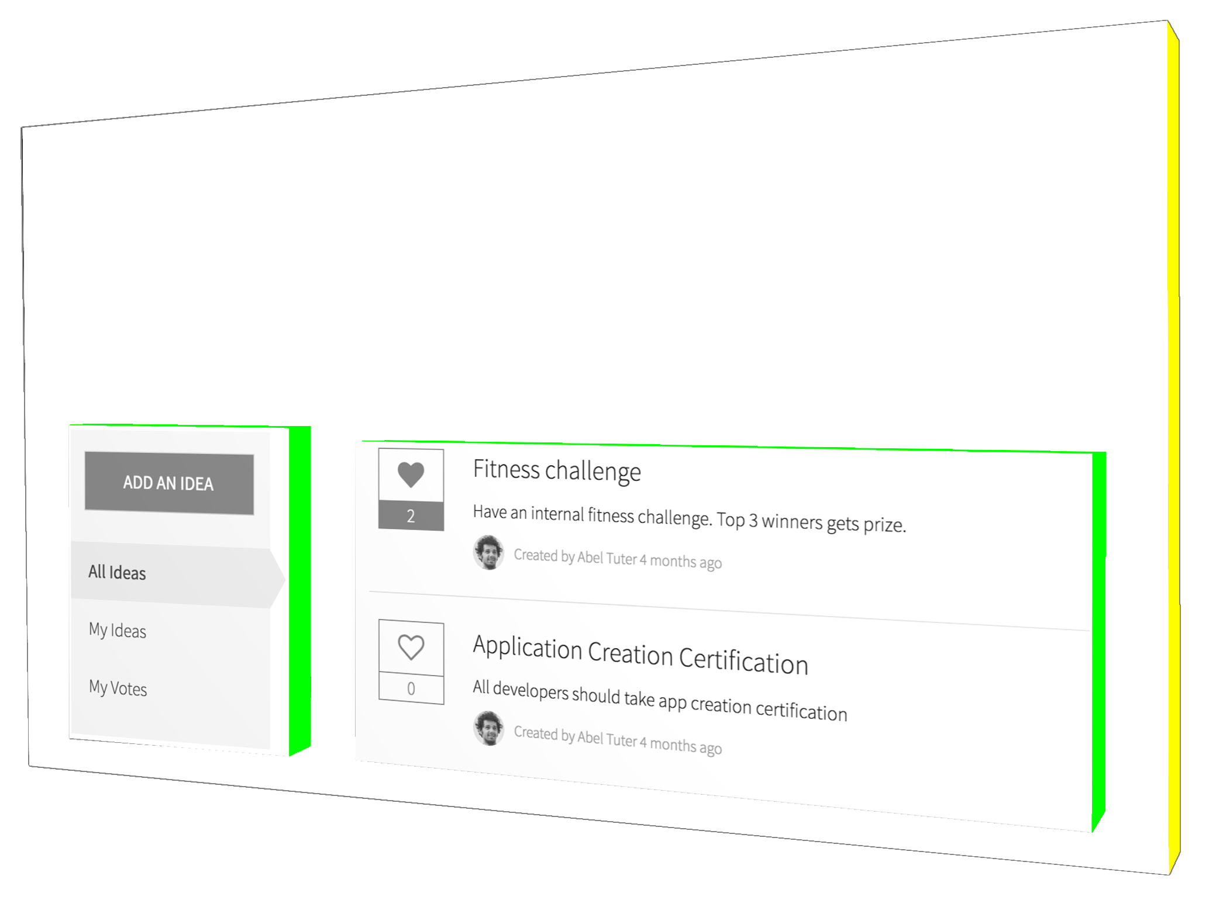
How will we use it?
We will use $rootScope.$broadcast() in the Idea Sidebar widget to reach up to the root scope and broadcast the event.
The event will be heard by all scopes on the page.
In the Idea List widget we will listen for that event using $scope.$on().
$rootScope.$broadcast()
$scope.$on()

Slide 20
Exercise 5
List Widget

Slide 21
Exercise 6
Submit an Idea Page

Slide 22
Bonus Exercise!
Data Tables

Slide 23
Questions?

Slide 24
Thank You!
Sushruth Chandrashekar | sushruth.chandrashekar@servicenow.com
Dylan Lindgren | @dylanlindgren | dylan.lindgren@servicenow.com

